Slide 1
Hospital Management System
By
Mattapalli Maheswar
Emp.Id 189451

Slide 2
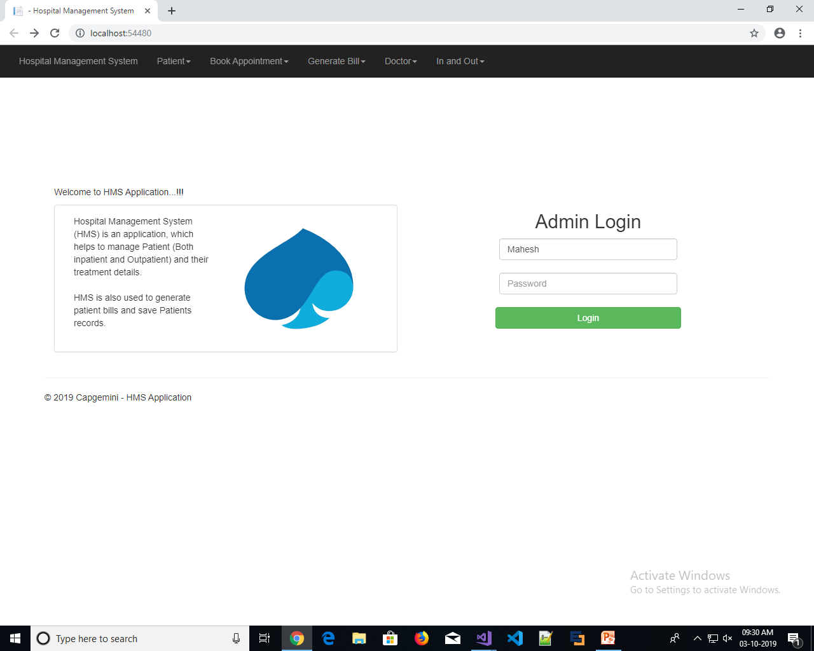
Introduction
Hospital Management System (HMS) is an application, which helps to manage Patient(Both inpatient and Outpatient) and their treatment details.HMS is also used to generate patient billsand save Patients records in every aspect.

Slide 3
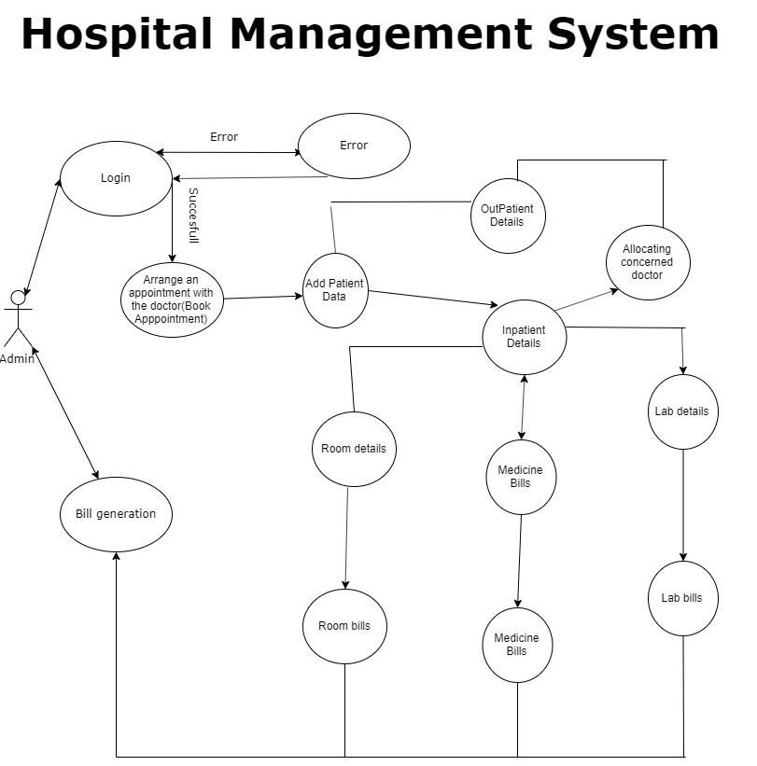
Use Case Diagram

Slide 4
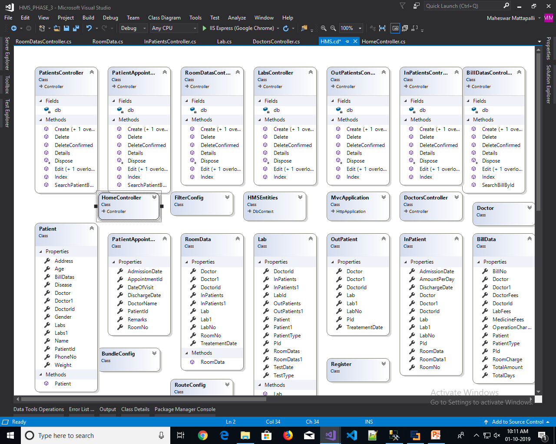
Class Diagram For MVC

Slide 5
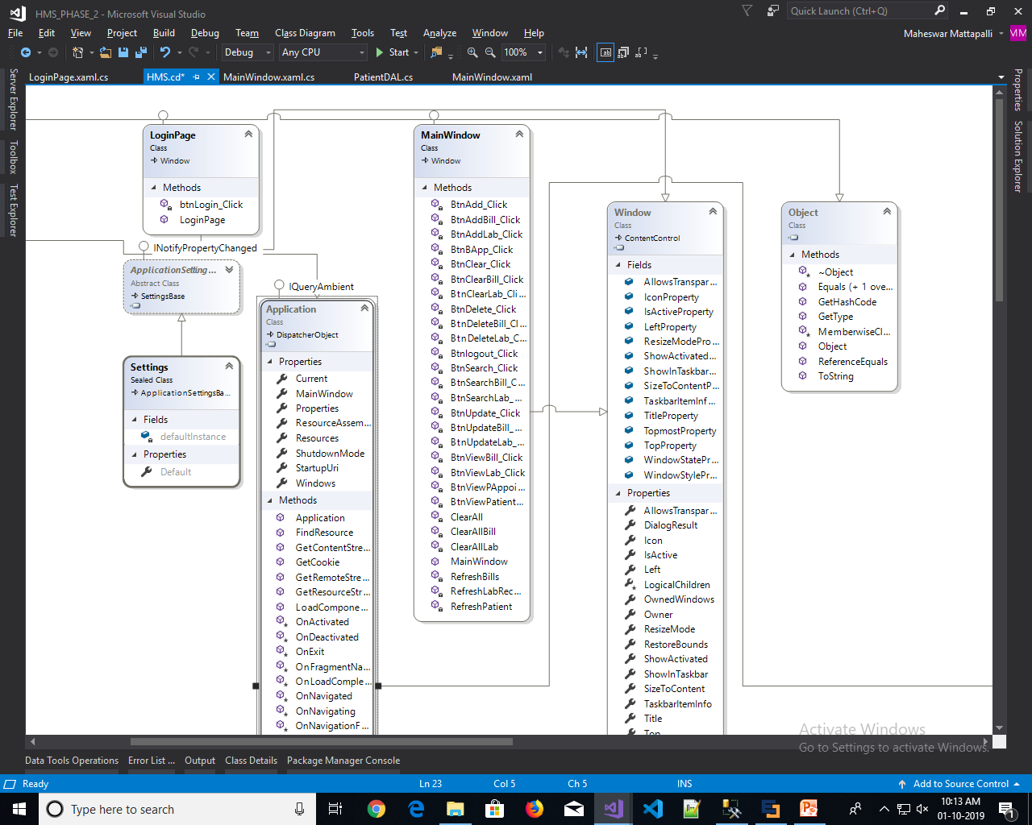
Class Diagram For WPF

Slide 6
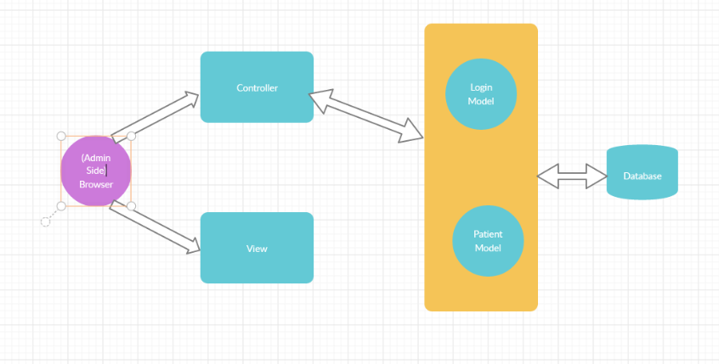
Architecture For MVC

Slide 7
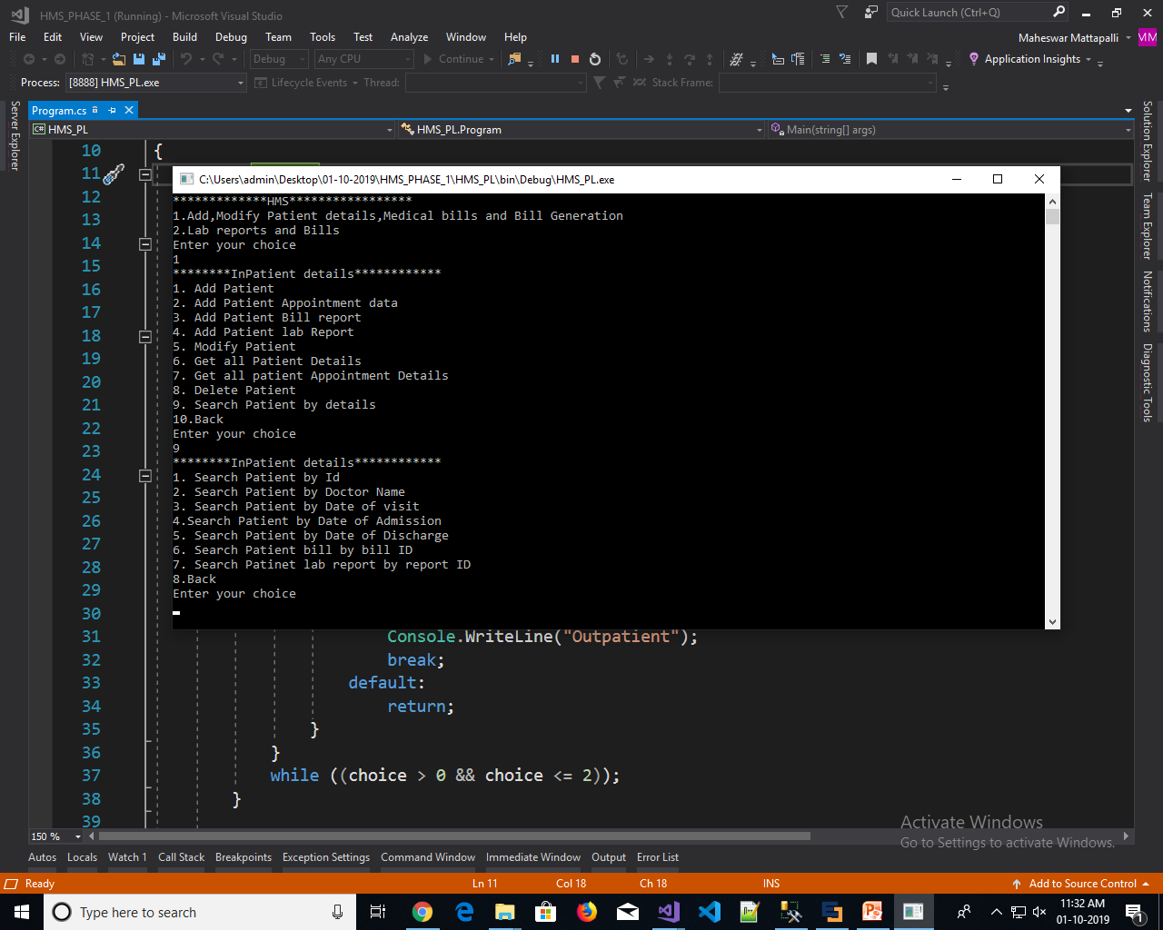
HMS Console Application - Screenshots

Slide 8
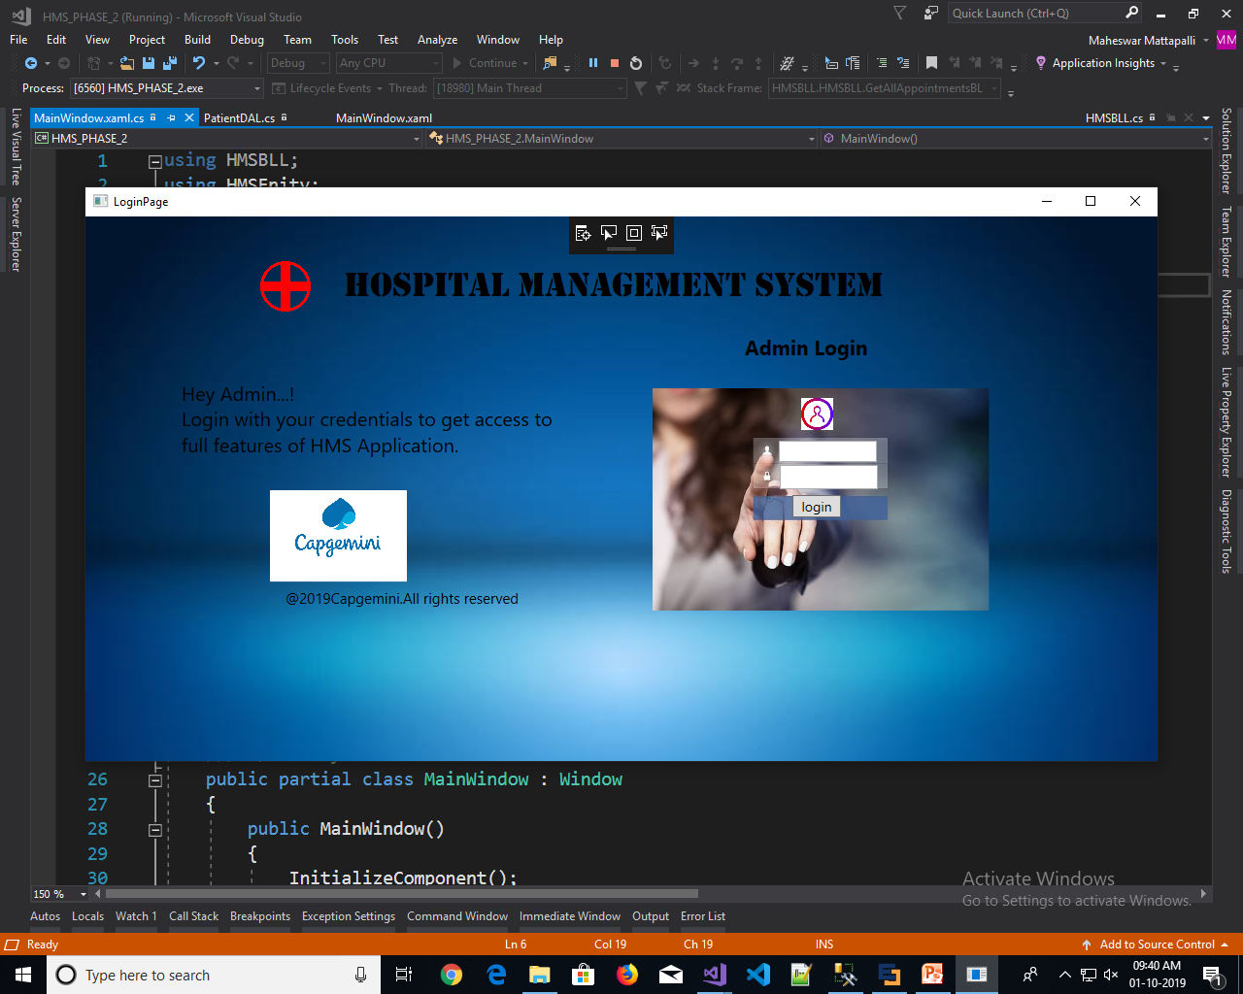
HMS WPF Application – Screenshots Login Page

Slide 9
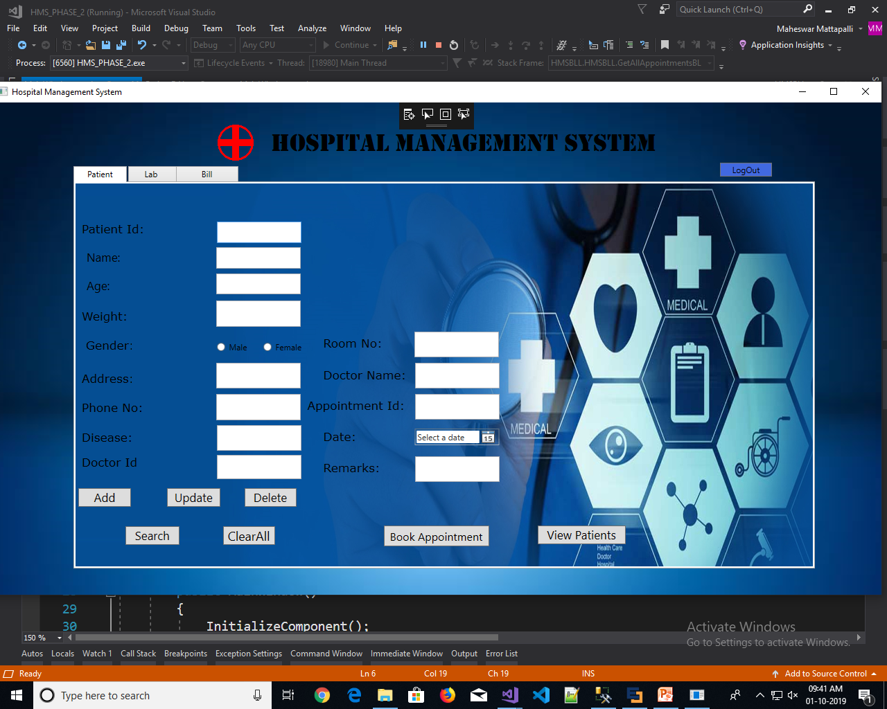
HMS WPF Application – Screenshots

Slide 10
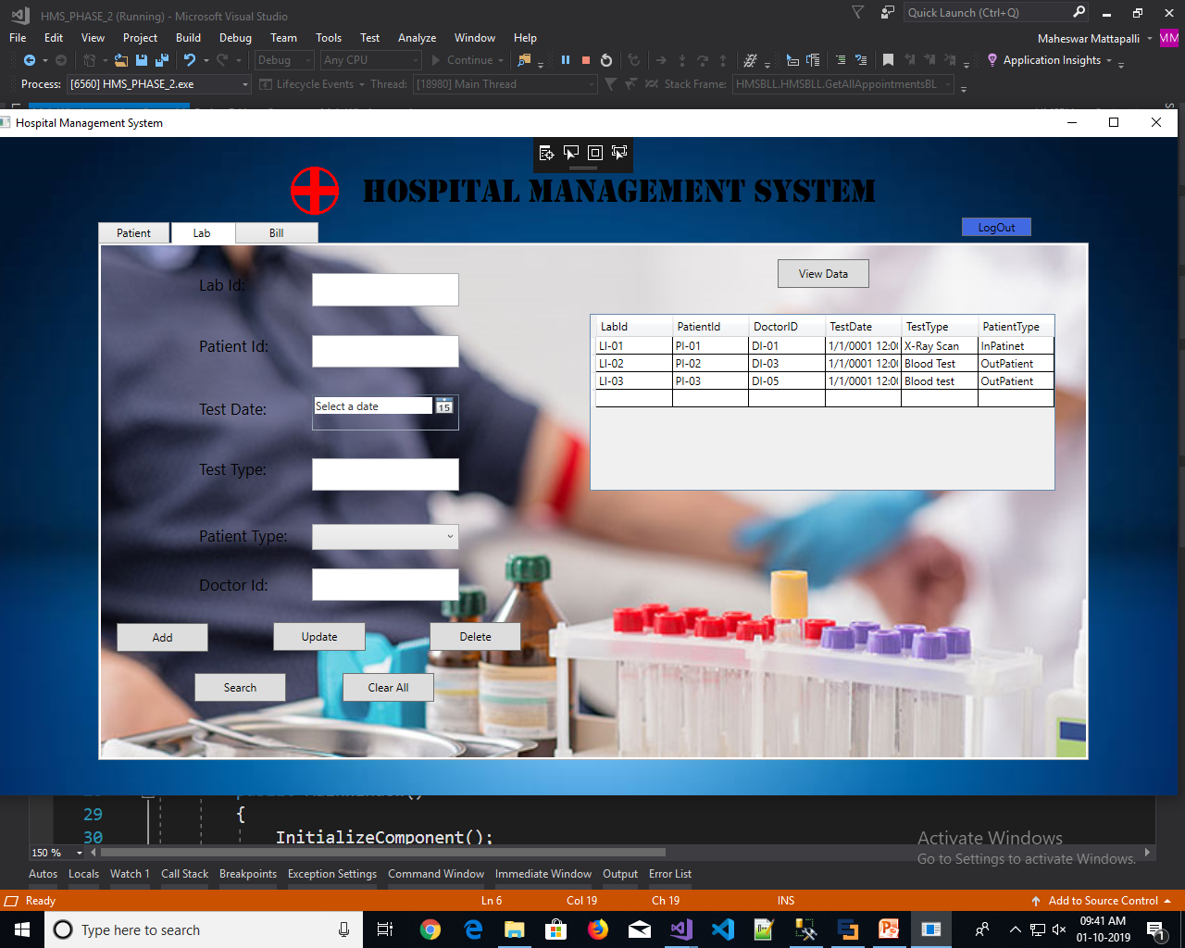
HMS WPF Application – Screenshots

Slide 11
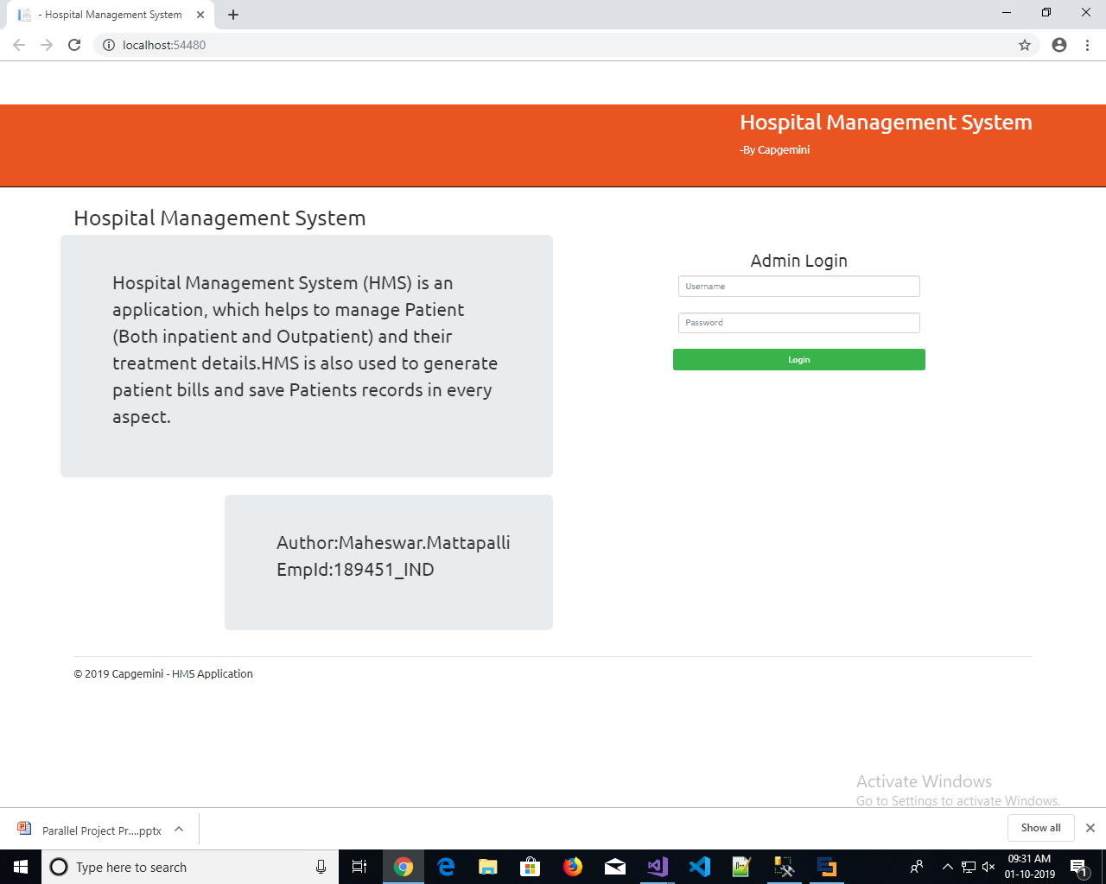
HMS ASP.NET Mvc - Screenshots Login Page

Slide 12
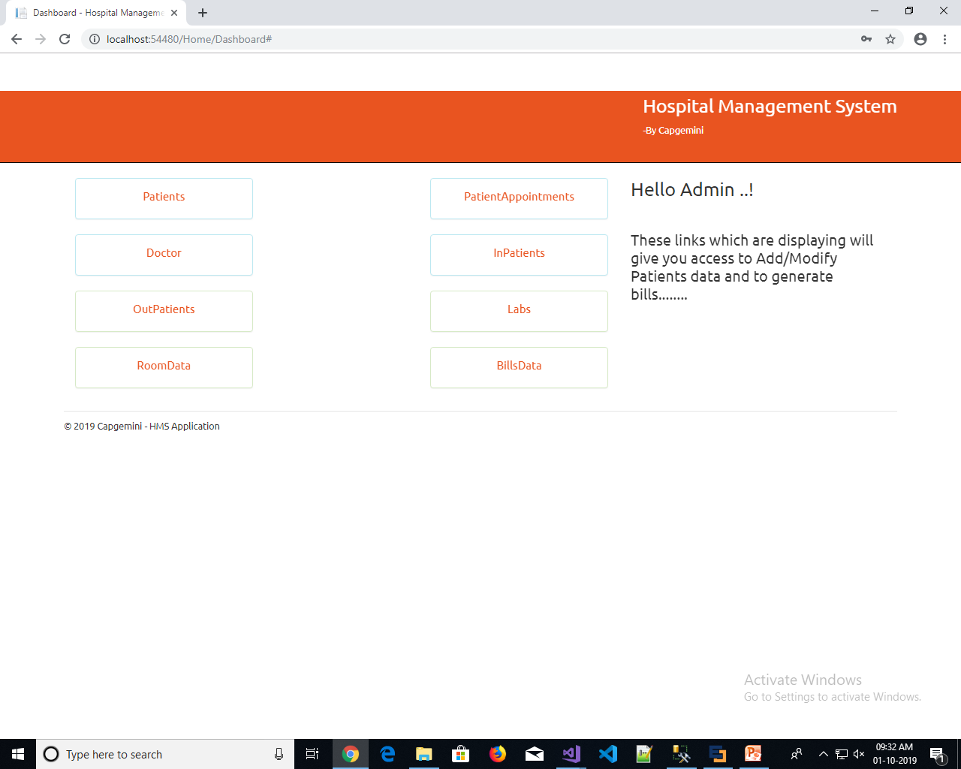
HMS ASP.NET Mvc - Screenshots CRUD Operations

Slide 13
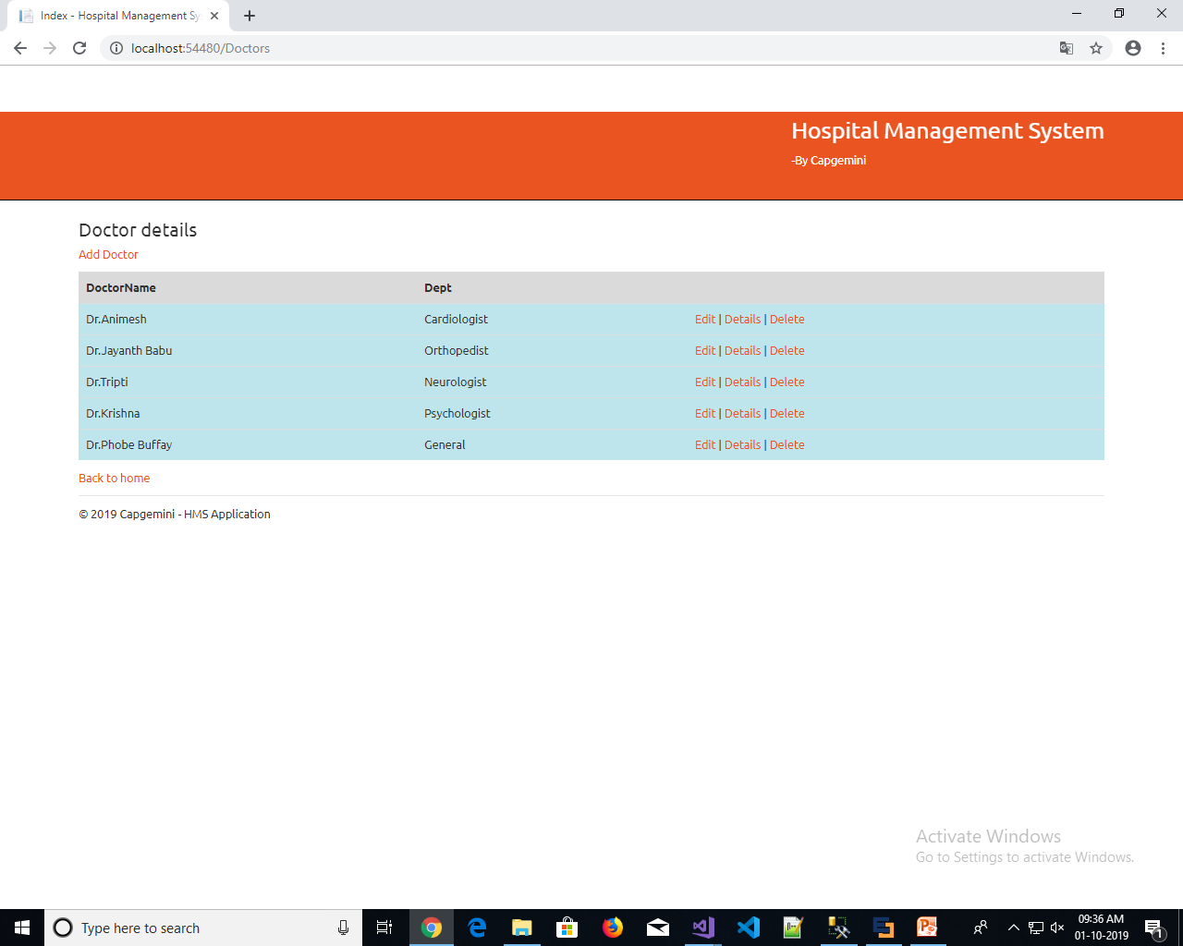
HMS ASP.NET Mvc - Screenshots Listing data

Slide 14

Future Enhancement
Can design more interactive webpages using bootstrap and can make easy user interface.
Can implement for multiple users like admin,patient,reception etc…

Slide 15

Thank You, Mattapalli.Maheswar ID:189451

